Slide 1
Data Warehousing and Data Mining
Unit 6
Classification and Prediction

Slide 2
Classification vs. Prediction
Classification
predicts categorical class labels
classifies data based on the training set and the values (class labels) in a classifying attribute and uses it in classifying new data
Prediction
predicts unknown or missing values
Typical applications
Credit approval
Target marketing
Medical diagnosis
Fraud detection

Slide 3
Classification—A Two-Step Process
Model construction: describing a set of predetermined classes
Each tuple/sample is assumed to belong to a predefined class, as determined by the class label attribute
The set of tuples used for model construction is training set
The model is represented as classification rules, decision trees, or mathematical formulae
Model usage: for classifying future or unknown objects
Estimate accuracy of the model
The known label of test sample is compared with the classified result from the model
Accuracy rate is the percentage of test set samples that are correctly classified by the model
Test set is independent of training set, otherwise over-fitting will occur
If the accuracy is acceptable, use the model to classify data tuples whose class labels are not known

Slide 4
Process (1): Model Construction
Classification
Algorithms
Training
Data
Classifier
(Model)
IF rank = ‘professor’
OR years > 6
THEN tenured = ‘yes’

Slide 5
Process (2): Using the Model in Prediction
Classifier
Testing
Data
Unseen Data
(Jeff, Professor, 4)
Tenured?

Slide 6
Issues: Data Preparation
Data cleaning
Preprocess data in order to reduce noise and handle missing values
Relevance analysis (feature selection)
Remove the irrelevant or redundant attributes
Data transformation
Generalize and/or normalize data

Slide 7
Issues: Evaluating Classification Methods
Accuracy
classifier accuracy: predicting class label
predictor accuracy: guessing value of predicted attributes
Speed
time to construct the model (training time)
time to use the model (classification/prediction time)
Robustness: handling noise and missing values
Scalability: efficiency in disk-resident databases
Other measures, e.g., goodness of rules, such as decision tree size or compactness of classification rules

Slide 8
Classification Algorithm
Baye's Theorem
Decision Trees
Back Propagation Algorithm
SVM (Support Vector Machine)
Introduction to Regression

Slide 9

Bayesian methods
Learning and classification methods based on probability theory.
Baye’s theorem plays a critical role in probabilistic learning and classification.
Uses prior probability of each category given no information about an item.
Categorization produces a posterior probability distribution over the possible categories given a description of an item.
P(A|B) =

Slide 10
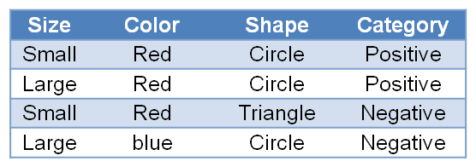
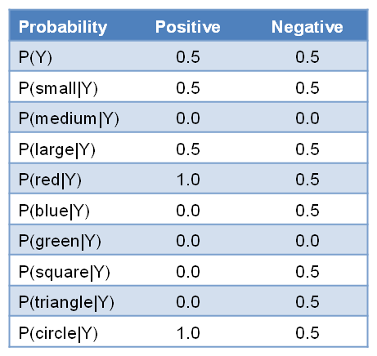
Bayesian methods...
AFTER TRAINING
D =
Size<small, medium, large>
Color<red, blue, green>
Shape<circle, triangle, square>
Category<positive, negative>

Slide 11
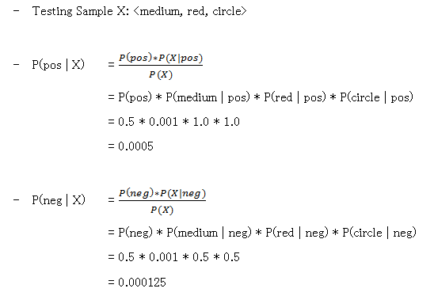
Bayesian methods...

Slide 12
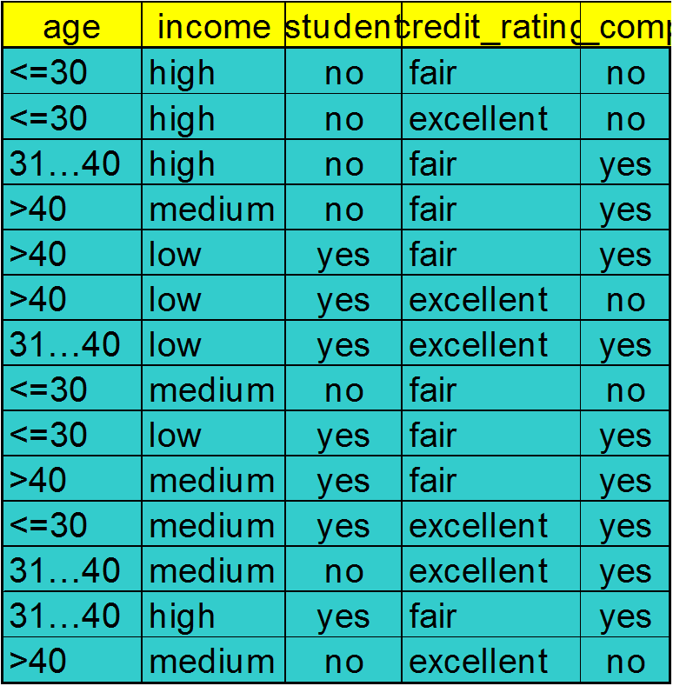
Naïve Bayesian Classifier: Training Dataset
Class:
C1:buys_computer = ‘yes’
C2:buys_computer = ‘no’
Data sample
X = (age <=30,
Income = medium,
Student = yes
Credit_rating = Fair)

Slide 13
Naïve Bayesian Classifier: An Example
P(C_{i}): P(buys_computer = “yes”) = 9/14 = 0.643
P(buys_computer = “no”) = 5/14= 0.357
Compute P(X|C_{i}) for each class
P(age = “<=30” | buys_computer = “yes”) = 2/9 = 0.222
P(age = “<= 30” | buys_computer = “no”) = 3/5 = 0.6
P(income = “medium” | buys_computer = “yes”) = 4/9 = 0.444
P(income = “medium” | buys_computer = “no”) = 2/5 = 0.4
P(student = “yes” | buys_computer = “yes) = 6/9 = 0.667
P(student = “yes” | buys_computer = “no”) = 1/5 = 0.2
P(credit_rating = “fair” | buys_computer = “yes”) = 6/9 = 0.667
P(credit_rating = “fair” | buys_computer = “no”) = 2/5 = 0.4
X = (age <= 30 , income = medium, student = yes, credit_rating = fair)
P(X|C_{i}) : P(X|buys_computer = “yes”) = 0.222 x 0.444 x 0.667 x 0.667 = 0.044
P(X|buys_computer = “no”) = 0.6 x 0.4 x 0.2 x 0.4 = 0.019
P(X|C_{i})*P(C_{i}) : P(X|buys_computer = “yes”) * P(buys_computer = “yes”) = 0.028
P(X|buys_computer = “no”) * P(buys_computer = “no”) = 0.007
Therefore, X belongs to class (“buys_computer = yes”)

Slide 14
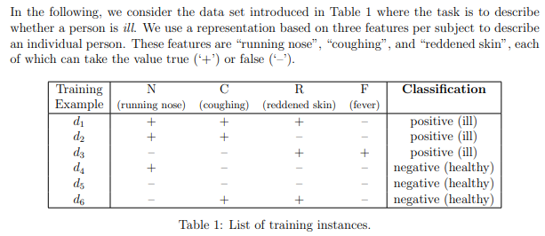
Bayesian Classifier…………………….
Classify the following
d7 = (¬N,C, ¬ R,F)
d8 = (N, ¬ C, ¬ R,F)
d9 = (N, ¬ C,R, ¬ F)

Slide 15
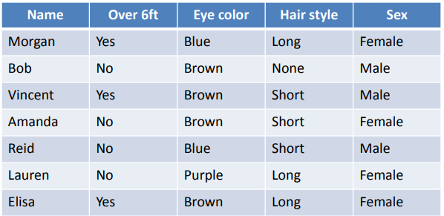

Bayesian Classifier…………………….

Slide 16
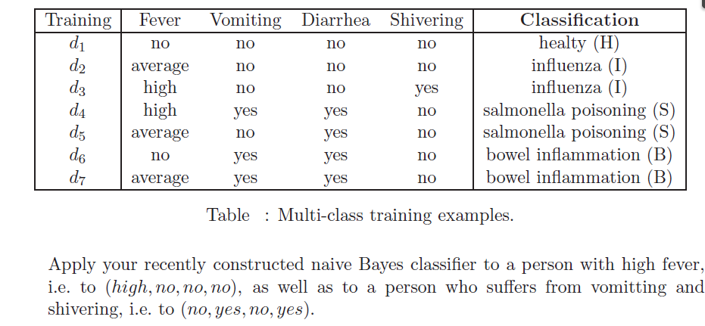
Bayesian Classifier…………………….

Slide 17
Laplace Smoothing
What if any count is ZERO
Pretend you saw every outcome k extra times
P_{LAP,k}(x) = [c(x) + k] / [N + k×|X|], where |X| is the number of possible outcome of X
k = 0, means simply it is the naïve Bayesian classification without smoothing
Example
P_{LAP,0}(x) = {2/3, 1/3}
P_{LAP,1}(x) = {3/5, 2/5}
P_{LAP,100}(x) = ?
(2 + 1) / (3 + 1*2), suppose possible outcome of X is 2 {YES,NO}
(102/203, 101/203)

Slide 18
Decision Trees
Decision tree induction is the learning of decision trees from class labeled training tuples.
A decision tree is a flowchart like tree structure where each internal node denotes a test on an attribute, each branch represents an outcome of the test and each node holds a class label

Slide 19
Decision Trees...
Age ?
youth
senior
Student ?
middle-aged
Credit_rating ?
no
yes
fair
excellent
YES
NO
YES
NO
YES

Slide 20
Decision Trees...(Example)
Day | Outlook | Temperature | Humidity | Wind | Play Tennis
D1 | SUNNY | HOT | HIGH | WEAK | NO
D2 | SUNNY | HOT | HIGH | STRONG | NO
D3 | OVERCAST | HOT | HIGH | WEAK | YES
D4 | RAIN | MILD | HIGH | WEAK | YES
D5 | RAIN | COOL | NORMAL | WEAK | YES
D6 | RAIN | COOL | NORMAL | STRONG | NO
D7 | OVERCAST | COOL | NORMAL | STRONG | YES
D8 | SUNNY | MILD | HIGH | WEAK | NO
D9 | SUNNY | COOL | NORMAL | WEAK | YES
D10 | RAIN | MILD | NORMAL | WEAK | YES
D11 | SUNNY | MILD | NORMAL | STRONG | YES
D12 | OVERCAST | MILD | HIGH | STRONG | YES
D13 | OVERCAST | HOT | NORMAL | WEAK | YES
D14 | RAIN | MILD | HIGH | STRONG | NO
Outlook <sunny, overcast, rain>
Temperature <hot, mild, cool>
Humidity <high, normal>
Wind <weak, strong>
Play Tennis <no, yes>

Slide 21
BUILDING DECISION TREE
Humidity
high
normal
d1,d2,d3,d4,d8,d12,d14
d5,d6,d7,d9,d10,d11,d13
Wind
Outlook
strong
weak
sunny
overcast
rain
d2,d12,d14
d1,d3,d4,d8
d9,d11
d5,d6,d10
d7,d13
Outlook
Outlook
yes
Wind
yes
sunny
overcast
strong
weak
rain
sunny
overcast
d2
d12
rain
d6
d5,d10
no
d14
yes
no
yes
no
d1,d8
d4
d3
no
yes
yes
Testing : <sunny, hot, normal, weak> → YES

Slide 22
Information gain
ID3 uses information gain as its attribute selection measure
Based on the value or “information content” of messages
Let node N represent or hold the tuples of partition D
The attribute with the highest information gain is chosen as the splitting attribute for node N
This attribute minimizes the information needed to classify the tuples in the resulting partitions

Slide 23
Information gain...
Select the attribute with the highest information gain
Let p_{i} be the probability that an arbitrary tuple in D belongs to class C_{i}, estimated by |C_{i, D}|/|D|
Expected information (entropy) needed to classify a tuple in D:
Information needed (after using A to split D into v partitions) to classify D:
Information gained by branching on attribute A
Notes:
I : the expected information needed to classify a given sample
E (entropy) : expected information based on the partitioning into subsets by A

Slide 24
Attribute Selection: Information Gain
Class P: buys_computer = “yes”
Class N: buys_computer = “no”
means “age <=30” has 5 out of 14 samples, with 2 yes’es and 3 no’s. Hence
Similarly,

Slide 25
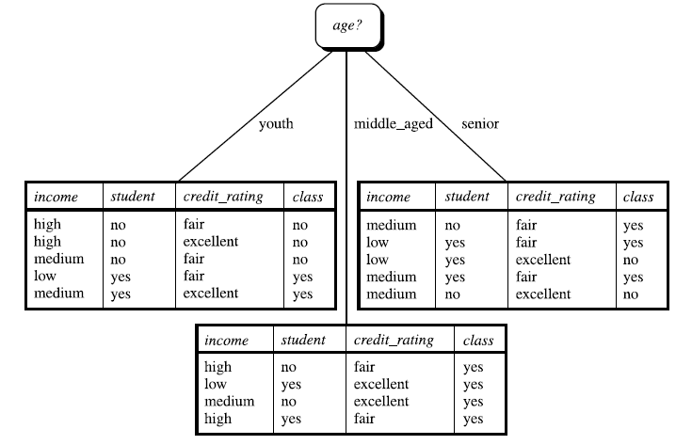
Information gain....
Because age has the highest information gain among the attributes, it is selected as the splitting attribute

Slide 26
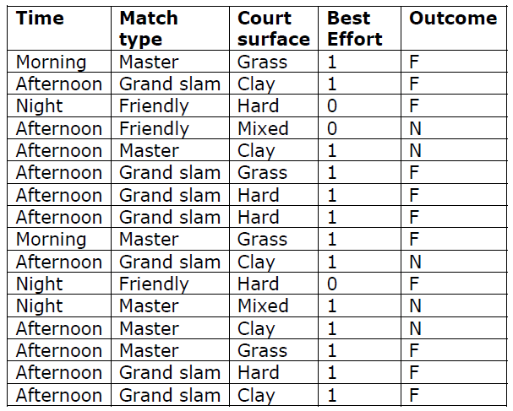
Decision Tree (Exercise)

Slide 27
Classification by Backpropagation
Backpropagation: A neural network learning algorithm
Started by psychologists and neurobiologists to develop and test computational analogues of neurons
A neural network: A set of connected input/output units where each connection has a weight associated with it
During the learning phase, the network learns by adjusting the weights so as to be able to predict the correct class label of the input tuples
Also referred to as connectionist learning due to the connections between units

Slide 28
A Multi-Layer Feed-Forward Neural Network
Output vector
Output layer
Hidden layer
w_{ij}
Input layer
Input vector: X

Slide 29
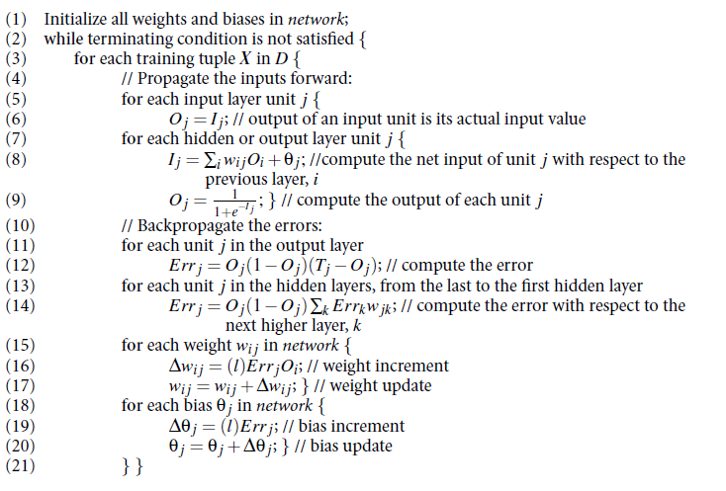
Algorithm

Slide 30
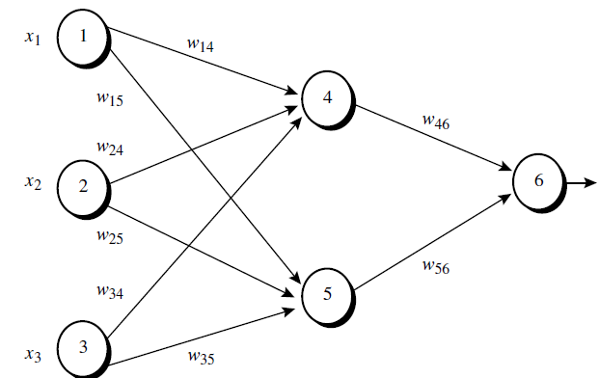
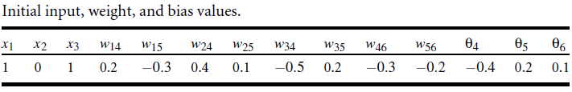
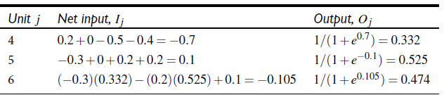
Example
Trace for O4
I4=O1*W14+O2*W24+O3*W34+θ4
I4=1*0.2+0*0.4+1*(-0.5)+(-0.4)=-0.7
O4=1/(1+e∧-I4)=1/(1+e∧0.7)=0.332
Repeat Until Err6 ≈ 0
W14(new)=W14(old)+(0.9)*Err4*O1
W15(new)=W15(old)+(0.9)*Err5*O1
……….So on
Update the weight
Step 1:- Initialize Input, Weight and Bias
Err6 = O6(1-O6)(T-O6)=O6(1-O6)(1-O6)
Err5 = O5(1-O5) * Err6 * W56
Err4 = O4(1-O4) * Err6 * W46
Step 3:- Calculate the Error
Step 2:- Calculate the output
For input layer
O1=x1=1, O2=x2=0, O3=x3=1
For hidden and output layer

Slide 31
Rule Based Classifier
Rule based classifiers, where the learned model is represented as a set of IF-THEN rules
Has the expression of the form
IF condition THEN conclusion
Example
R1 : IF age = youth AND student = yes THEN buys_computer = yes
“IF” part of the rule is called antecedent or pre-condition , and “THEN” part is called consequent
If the condition in a rule holds true for a given tuple, we say that the rule antecedent is satisfied and the rule covers the tuple

Slide 32


Rule Based Classifier…
A rule R can be assessed by its coverage and accuracy
Given a tuple, X, from a class labelled data set, D
Let
N_{covers} be the number of tuples covered by R
N_{correct} be the numbers of tuples correctly classified by R
|D| be the numbers of tuples in D
Then, we can define coverage and accuracy of R as and

Slide 33
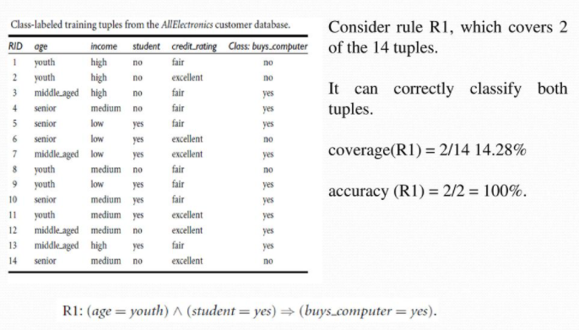
Rule Based Classifier…
Example

Slide 34
Rule Based Classifier…
Suppose we have to predict the class label of X
If a rule is satisfied by X, the rule is said to be triggered
If R1 is only one rule satisfied, then the rule fires by returning the class prediction of R1
If more than one rule is triggered, need a conflict resolution strategy (ordering scheme → highest priority)
i.e. with rule ordering, the triggering rule that appears earliest in the list has the highest priority, and so it gets to fire its class prediction
What if there is no rule satisfied by X (default class)

Slide 35
Rule Based Classifier…
Rule extraction from a decision tree
To extract rules from a decision tree, one rule is created for each path from the root to a leaf node
Each splitting criterion along a given path is logically ANDed to form the rule antecedent (IF part)
The leaf node holds the class prediction, forming the consequent (THEN part)

Slide 36
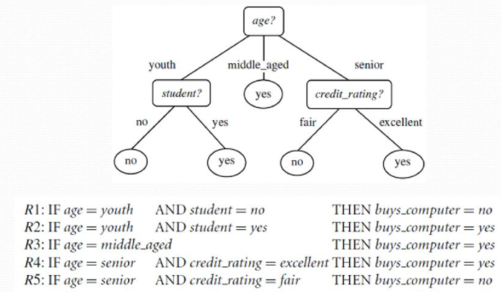
Rule Based Classifier…
Rule extraction from a decision tree…
Example

Slide 37
Rule Based Classifier…
Rule extraction from a decision tree…
Rules extracted from decision tree are mutually exclusive
i.e. no two rules can be fired for the same tuple
The rules extracted from decision tree suffer from sub-tree repetition and replication can be large
So we may need to prune the rule set
For a given rule antecedent, any condition that does not improve the estimated accuracy of the rule can be pruned
Default class → one that contains most training tuples not covered by any rule

Slide 38
Support Vector Machine (SVM)
A new classification method for both linear and nonlinear data
It uses a nonlinear mapping to transform the original training data into a higher dimension
With the new dimension, it searches for the linear optimal separating hyperplane (“decision boundary”)
With an appropriate nonlinear mapping to a sufficiently high dimension, data from two classes can always be separated by a hyperplane
SVM finds this hyperplane using support vectors (“essential” training tuples) and margins (defined by the support vectors)

Slide 39
Support Vector Machine (SVM)…
denotes +1
denotes -1
How would you classify this data?

Slide 40
Support Vector Machine (SVM)…
denotes +1
denotes -1
How would you classify this data?

Slide 41
Support Vector Machine (SVM)…
denotes +1
denotes -1
How would you classify this data?

Slide 42
Support Vector Machine (SVM)…
denotes +1
denotes -1
How would you classify this data?

Slide 43
Support Vector Machine (SVM)…
denotes +1
denotes -1
Any of these would be fine..
..but which is best?

Slide 44
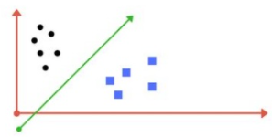
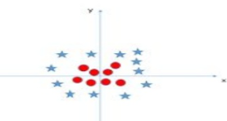
Support Vector Machine (SVM)…
Linearly Separable Data
Non Linearly Separable Data

Slide 45
Support Vector Machine (SVM)…
Margin
Is the perpendicular distance between the closest data points and the hyper planes (on both sides)
The best optimized line (hyperplane) with maximum margin is called as Margin Maximal Hyperplane
The closest points where the margin distance is calculated are considered as support vectors
Choose the hyperplane having margin with maximum width

Slide 46

Support Vector Machine (SVM)…

Slide 47
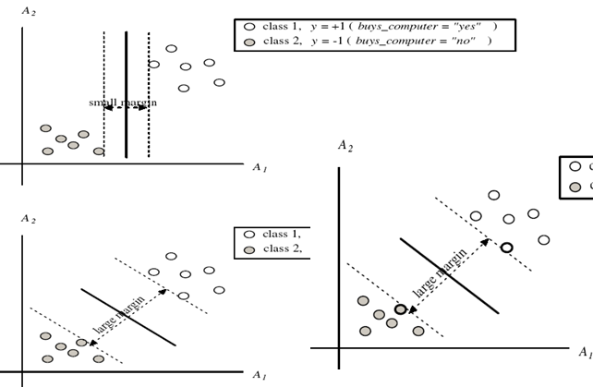
Support Vector Machine (SVM)…

Slide 48
Evaluating Classifiers
Precision, Recall, F-Measure
Confusion matrix
Precision(P) = (TP)/(TP+FP)
Recall(R) = (TP)/(TP+FN)
F-measure = (2*P*R) / (P+R)
 | C₁ | C₂
C₁ | True positive | False negative
C₂ | False positive | True negative
classes | buy_computer = yes | buy_computer = no | total
buy_computer = yes | 6954 | 46 | 7000
buy_computer = no | 412 | 2588 | 3000
total | 7366 | 2634 | 10000

Slide 49
Overfitting and Underfitting
Overfitting
Due to excess knowledge of attributes where the model tries to use all the attributes
Large training set but unseen testing data
Underfitting
Due to lack of enough attributes, model doesn't has enough knowledge and gives incorrect results
Less training data set

Slide 50
K – Fold Cross Validation
Cross validation is the model validation technique for accessing how the result of the statistical analysis will generalize to an independent data set
In k-fold cross-validation, the original sample is randomly partitioned into k equal sized sub samples
Of the k subsamples, a single subsample is retained as the validation data for testing the model, and the remaining k − 1 subsamples are used as training data
i.e. if k = 5, (5 – fold validation), first divide the data into 5 equal parts, then use 4 parts for training and 1 part for testing

Slide 51
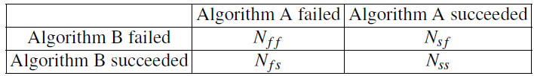
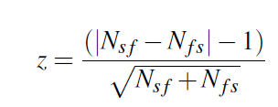
Model Comparison
A
cat-plant
fish-animal
rose-plant
B
cat-animal
fish-animal
rose-plant
Nff=0
Nsf=0
Nfs=1
Nss=2
McNemar’s test
Compare the two classifier
Based on the following contingency table
Compute
If z = 0, the two algorithms are said to show similar performance

Slide 52
Model Comparison…
Example
Algorithm A
Cat → Plant (Wrong Classification)
Tiger → Animal (Right Classification)
Rose → Plant (Right Classification)
Algorithm B
Cat → Animal (Right Classification)
Tiger → Animal (Right Classification)
Rose → Plant (Right Classification)
Here
Nff = 0, Nsf = 0, Nfs = 1, Nss = 2
Z= (|Nsf - Nfs| - 1) / (Sqrt(Nsf+Nfs)) = 0
i.e. Both algorithm have similar performance

Slide 53
End of Session

